Slide 1

ATM using Python
Under Guidance of :
Submitted By:
Shalinee K
Subhamita K
Chinmayee N
Prakash T
Shalini Kumari

Slide 2

INTRODUCTION
Python is a powerful programming language that can be used to develop a wide range of applications. One of the most popular is an ATM machine project. This project can be used to create an automated banking system that can be used by customers to access their accounts and perform transactions.

Slide 3
Goal of the project
The goal of creating an ATM machine using Python is to simulate the basic functionalities of a real ATM machine, such as withdrawing cash, checking account balance, and depositing cash, among others.
The project aims to provide a user-friendly interface that allows users to interact with the system and perform transactions with ease. Additionally, the project should implement security features such as PIN verification and encryption to ensure the safety of user data and prevent unauthorized access to the system.
Overall, the main goal of the project is to create a functional and secure ATM machine using Python that can be used as a learning tool for individuals who want to learn more about programming and software development.

Slide 4
Design and Development
create_pin(): This method sets up a new PIN code for the user, and ensures that the PIN is 4 digits long. If the user enters an invalid PIN, they are prompted to enter a new one until they get it right.
handle_wrong_pin():This function is used to authenticate the user by matching his PIN with the account details stored in the accounts list. It takes user input for his PIN, and returns the user's account details if authentication is successful, and None otherwise.
check_balance(): This function is used to check the account balance of the authenticated user. It takes the user's account details as input, and returns the current balance.

Slide 5
Design and Development
deposit(): This function is used to deposit money into the authenticated user's account. It takes the user's account details and the deposit amount as input, and updates the account balance accordingly.
withdraw(): This function is used to withdraw money from the authenticated user's account. It takes the user's account details and the withdrawal amount as input, and updates the account balance if sufficient funds are available.
main(): This function is the main program that controls the flow of the ATM machine. It provides the user with a menu of options to choose from, including creating a new account, logging in, checking balance, depositing, withdrawing, and logging out.

Slide 6
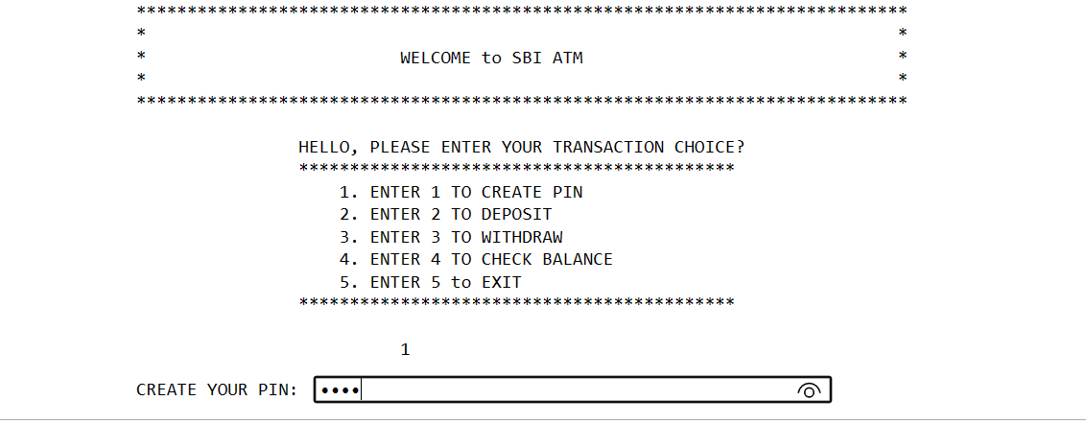
SUMMARY OF CODE
The user has selected the option "1" to create a new PIN for the ATM. The program prompts the user to enter a new PIN by displaying "CREATE YOUR PIN:" on the screen. The user then enters the new PIN by typing the digits. The program does not display the PIN on the screen but instead displays an asterisk (*) for each character typed, to maintain security and prevent anyone from seeing the PIN.

Slide 7
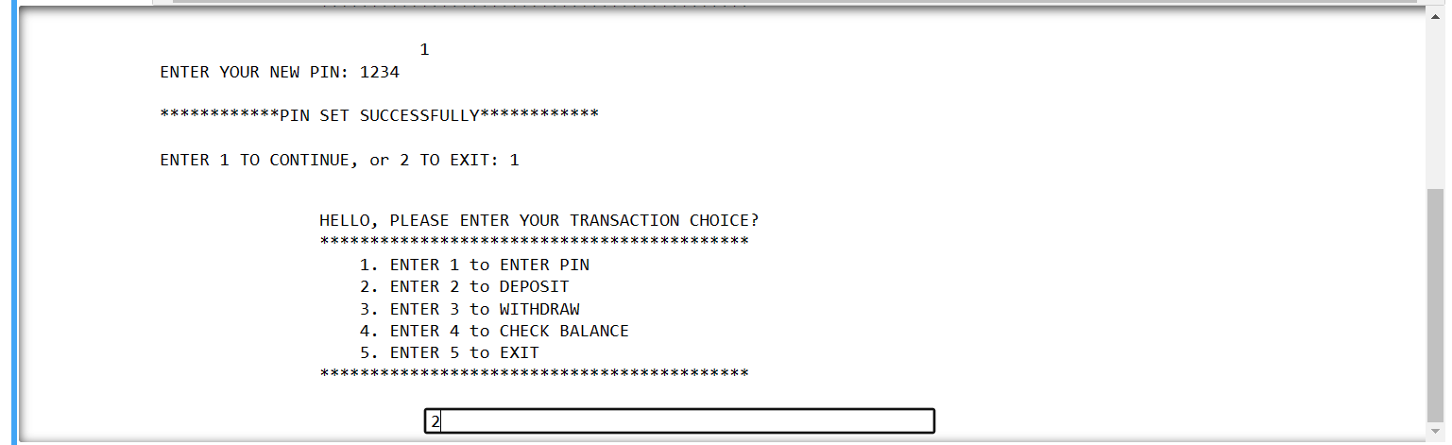
SUMMARY OF CODE
After the user successfully sets their PIN as "1234", the program prompts the user to enter "1" to continue or "2" to exit. The user enters "1", so the program displays the main menu options again and prompts the user to enter their choice of transaction.

Slide 8
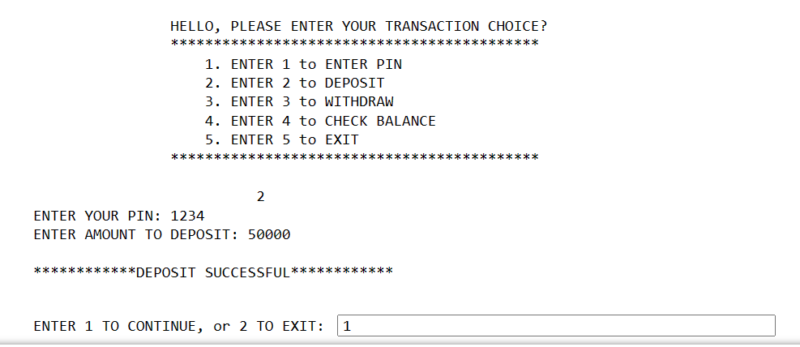
SUMMARY OF CODE
Then the he user has chosen to deposit money and has successfully completed the transaction. The ATM machine prompts the user to enter their PIN, which is "1234" in this case. Then, the user is asked to enter the amount they want to deposit, which is "50000" in this case. Finally, the ATM machine confirms that the deposit was successful.

Slide 9
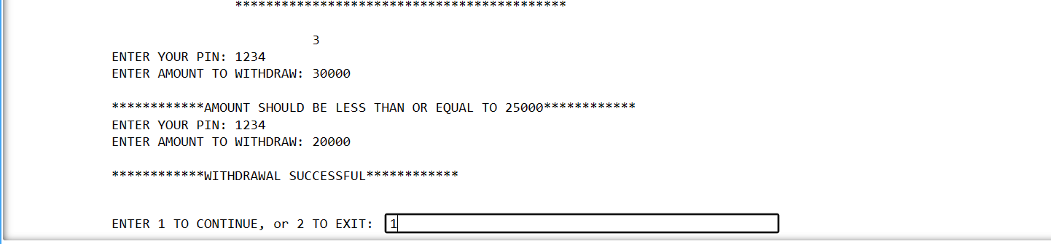
SUMMARY OF CODE
The user is attempting to withdraw money from their account. They first enter their PIN to authenticate themselves. Then they are prompted to enter the amount they want to withdraw. In this case, they initially tried to withdraw an amount greater than the maximum withdrawal limit of 25000, so they received an error message. They then attempted to withdraw 20000 which is within the limit, so the transaction was successful and they received a message confirming the withdrawal.

Slide 10
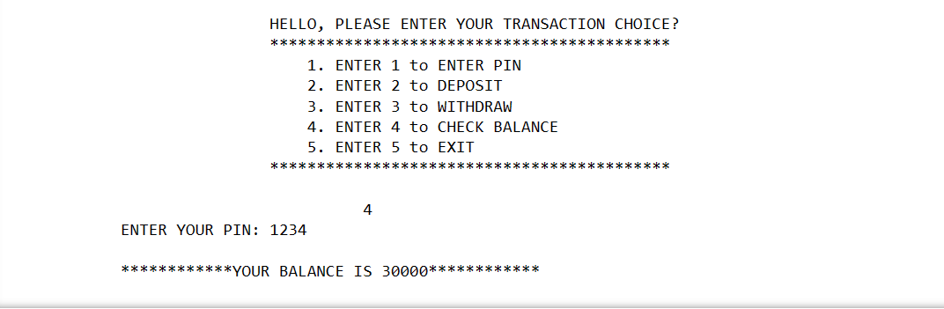
SUMMARY OF CODE
The user chose option 4 to check their account balance. They were prompted to enter their PIN and after providing the correct PIN, the ATM displays a message indicating "YOUR BALANCE IS 30000" which shows the current balance in the user's account.

Slide 11

DEMO
Double click on object to view file

Slide 12

REFERENCES
https://github.com/topics/atm-python-project
https://courses.telusko.com/learn/Python

Slide 13
CONCLUSIONS
This Python ATM project demonstrates the implementation of basic banking operations such as checking balance, depositing, and withdrawing money. It provides users with a simple interface to interact with an ATM machine, and the project's functionality is built around object-oriented programming principles. This project can be further improved by implementing additional features like transaction history, transfer funds, and user authentication. Overall, this project showcases how Python can be used to create practical applications that provide solutions to real-world problems.

Slide 14


